Slide 1
Credit Card Subscriber Segmentation
Analysis and Recommendations

Slide 2
Business Context
A Bank wants to develop a customer segmentation to define marketing strategy.
The sample dataset summarizes the usage behavior of about 9000 active credit card holders during the last 6 months.
The file at customer level includes Transaction frequency, amount, tenure etc.

Slide 3
Business Requirements
Bank Marketing team would like to leverage ML to launch target ad campaign that is tailored to specific group of customers. Based on this group or Market segments, marketing strategy will be formed.
Following Parameters would help marketing team to formulate better strategy,
Monthly average spend
Purchases type (EMI etc)
Average amount per purchase.
Clustering segments of credit card holders
Provide the strategic insights and implementation of strategies for given set of cluster characteristics

Slide 4
Data Dictionary
CUST_ID: Credit card holder ID
BALANCE: Monthly average balance (based on daily balance averages)
BALANCE_FREQUENCY: Ratio of last 12 months with balance
PURCHASES: Total purchase amount spent during last 12 months
ONEOFF_PURCHASES: Total amount of one-off purchases
INSTALLMENTS_PURCHASES: Total amount of installment purchases
CASH_ADVANCE: Total cash-advance amount
PURCHASES_ FREQUENCY: Frequency of purchases (Percent of months with at least one purchase)
ONEOFF_PURCHASES_FREQUENCY: Frequency of one-off-purchases
PURCHASES_INSTALLMENTS_FREQUENCY: Frequency of installment purchases
CASHADVANCE FREQUENCY: Cash-Advance frequency
AVERAGE_PURCHASE_TRX: Average amount per purchase transaction
CASH_ADVANCE_TRX: Average amount per cash-advance transaction
PURCHASES_TRX: Average amount per purchase transaction
CREDIT_LIMIT: Credit limit
PAYMENTS: Total payments (due amount paid by the customer to decrease their statement balance) in the period
MINIMUM_PAYMENTS: Total minimum payments due in the period.
PRC_FULL_PAYMEN: Percentage of months with full payment of the due statement balance
TENURE: Number of months as a customer

Slide 5
Methods used for Analysis
Exploratory Analysis to describe the data
K Means Clustering to Segment Customer

Slide 6
Exploratory Analysis Description
Average Monthly Purchase Amount is: 86.1751728841086
Minimum Monthly Purchase Amount is: 0.0
Maximum Monthly Purchase Amount is: 4086.630833333333
Average Customer Tenure (in Months) is: 11.51731843575419
Total Amount of Installment Purchases is: 3679055.42
Total Amount of One Off Purchases is : 5302314.470000001
Amount of purchases on Installment are much lower than One Off Purchases
There are customer who are not using CC

Slide 7
Exploratory Analysis Customer Spending Behavior
Both_Oneoff_and_Installment
Installment
No Activity
One_off
2774
2260
2042
1874
There are large set of Customer that are not using Credit Card for Purchase (may be using only for cash advance).
There are Customers that Perform Both Oneoff and Installment
Approx. 1800 Subs do not prefer Installment based transactions.

Slide 8
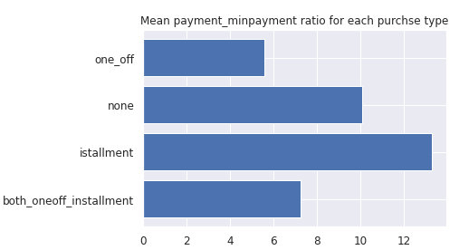
Exploratory Analysis Average Payment to Minimum payment ratio for each purchase type

Slide 9
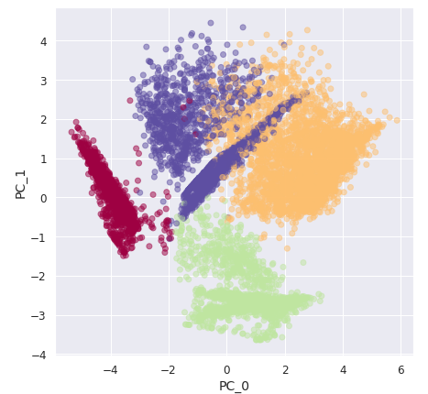
Cluster Analysis K Means, K = 4

Slide 10
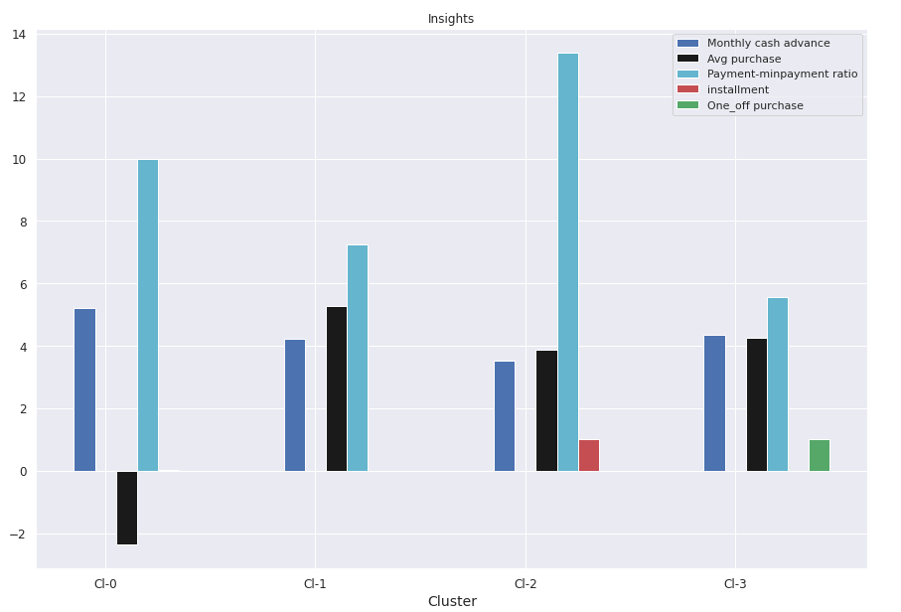
Cluster Analysis K Means, K = 4

Slide 11
Insights
Cluster 2 is the group of customers who have highest Monthly avg purchases and doing both installment as well as one_off purchases, have comparatively good credit score. This group is about 31% of the total customer base
cluster 1 is taking maximum advance cash and is paying comparatively less minimum payment and poor credit score & doing no purchase transaction. This group is about 23% of the total customer base
Cluster 0 customers are doing maximum One_Off transactions and least payment ratio and credit score on lower side This group is about 21% of the total customer base
Cluster 3 customers have maximum credit score and are paying dues and are doing maximum installment purchases. This group is about 25% of the total customer base

Slide 12
Conclusion
Group 2 They are potential target customers who are paying dues and doing purchases and maintaining comparatively good credit score ) -- we can increase credit limit or can lower down interest rate -- Can be given premium card /loyality cards to increase transactions
Group 1 They have poor credit score and taking only cash on advance. We can target them by providing less interest rate on purchase transaction
Group 0 This group is has minimum paying ratio and using card for just oneoff transactions (may be for utility bills only). This group seems to be risky group.
Group 3 This group is performing best among all as customers are maintaining good credit score and paying dues on time. -- Giving rewards point will make them perform more purchases.

